Slide 1


Sri Adichunchanagiri Shikshana Trust(R) S J B Institute of Technology
Department of Electronics & Communication Engineering
A Project On
Remote Authorization for ATM Transactions using Fingerprint and T-OTP
Review - II
Guided By:
Dr. K.V Mahendra Prashanth,
Head of Department,
Electronics & Communication, SJBIT ​
Done By:
Shreyas M.O [1JB17EC086]
Shreyas G [1JB17EC085]
Sumanth T.P [1JB17EC090]
Tejas Muthya [1JB17EC095]

Slide 2
Remote Authorization for ATM Transactions using Fingerprint and T-OTP
CONTENTS
Introduction
Objectives
Procedure
Motivation
Literature Survey
Comparison
Challenges
Methodology
Work Progress
Plan of Action
References

Slide 3
Remote Authorization for ATM Transactions using Fingerprint and T-OTP
INTRODUCTION
The idea behind this project is to embed multiple bank accounts of the user onto a single smart card.
The hardware used is, the Mifare Classic contact-less smartcard that holds a unique card number.
The mobile application is an interactive module through which the user can authenticate transactions.
The transaction is successfully completed when the user enters the time based OTP or scans his/her fingerprint through the application, depending on how advanced their device is.
Dept of ECE, SJBIT, 2020-21

Slide 4
Remote Authorization for ATM Transactions using Fingerprint and T-OTP
OBJECTIVES
Creating a user-friendly environment for ATM users by providing secured banking facility.​
​
User defined security password which is used to generate an TOTP. ​
Provides the system with a better security when compared to the system currently in use. ​
To provide a system with two staged authentication thereby ensuring better security.​
Dept of ECE, SJBIT, 2020-21

Slide 5
Remote Authorization for ATM Transactions using Fingerprint and T-OTP
LITERATURE SURVEY
SL No. | Title of the paper | Year of Publication | Method Proposed | Limitations
1 | OTP based Card less Transaction using ATM [1] | 2019 | Unique number named BPIN, which consists of 6-digit Bank Identification Number (BIN) and 4-digit Personal Identification Number (PIN) and OTP is used. | There is no fingerprint-based approach for the theft detection.
2 | Authentication Of Biometric System using Fingerprint Recognition with Euclidean Distance and Neural Network Classifier [2] | 2019 | Image acquisition and pre-processing for fingerprint verification algorithms. | There is no OTP based technology. Due to this reason, there is no two-level security in the proposed system.
3 | Security and Accuracy of Fingerprint based Biometrics: A review [3] | 2019 | Eight possible attack points to a typical biometric authentication system. | When the transaction is done from different ATMs, the user has to pay extra charges.
4 | Enhanced ATM Security System using GSM, GPS and Biometrics [4] | 2019 | 8 ways in which the fraudulent transactions that can occur in the ATM system. | Comparisons with existing approaches show comparable performance to traditional approaches using BCS and CB techniques.
5 | New Distribution Channels in banking Services [5] | 2018 | The law enforcement agencies that are responsible to enforce laws in fraud cases. | The user has to remember PINs for all the ATM cards that he has.

Slide 6
Remote Authorization for ATM Transactions using Fingerprint and T-OTP
LITERATURE SURVEY
SL No. | Title of the paper | Year of Publication | Method Proposed | Limitations
6 | Highly secure multiple account bank affinity Card-A successor for ATM card [6] | 2018 | Arduino Mega, RFID tag, RF Reader, RS232, Fingerprint scanner is used for the smart ATM card transaction. | Materials like metal and liquid can impact the signal when there is usage of RFID tags.
7 | Prevention of ATM Robbery Using Advance Security [7] | 2018 | Usage of fingerprint as biometric to prevent the ATM robbery. | The main drawback is the false rejection of users when a fingerprint scanner is used.
8 | ATM for visually challenged people [8] | 2017 | Assisting visually impaired people to access the ATM system with RSA algorithm implementation to encrypt and decrypt. | Requires user training in order for them to operate the system.
9 | Fingerprint Based Biometric ATM authentication System [9] | 2017 | Biometric Cryptosystem for VoIP Security using Key Generation technique. | The newly proposed approach involves key extraction, which is a resource consuming task.
Dept of ECE, SJBIT, 2020-21

Slide 7
MOTIVATION
Remote Authorization for ATM Transactions using Fingerprint and T-OTP
The motivation for doing this project was primarily undertaking a challenging project and solve an existing problem.
The recent technological advancements that are focusing on the development of smart systems to improve user experience has been a major motivating factor for us to undertake this project.
With India moving at a rapid pace towards digitization, smartphones will soon be a necessity for every citizen. Such developments in the years coming will definitely make way for authentication through smartphones.

Slide 8
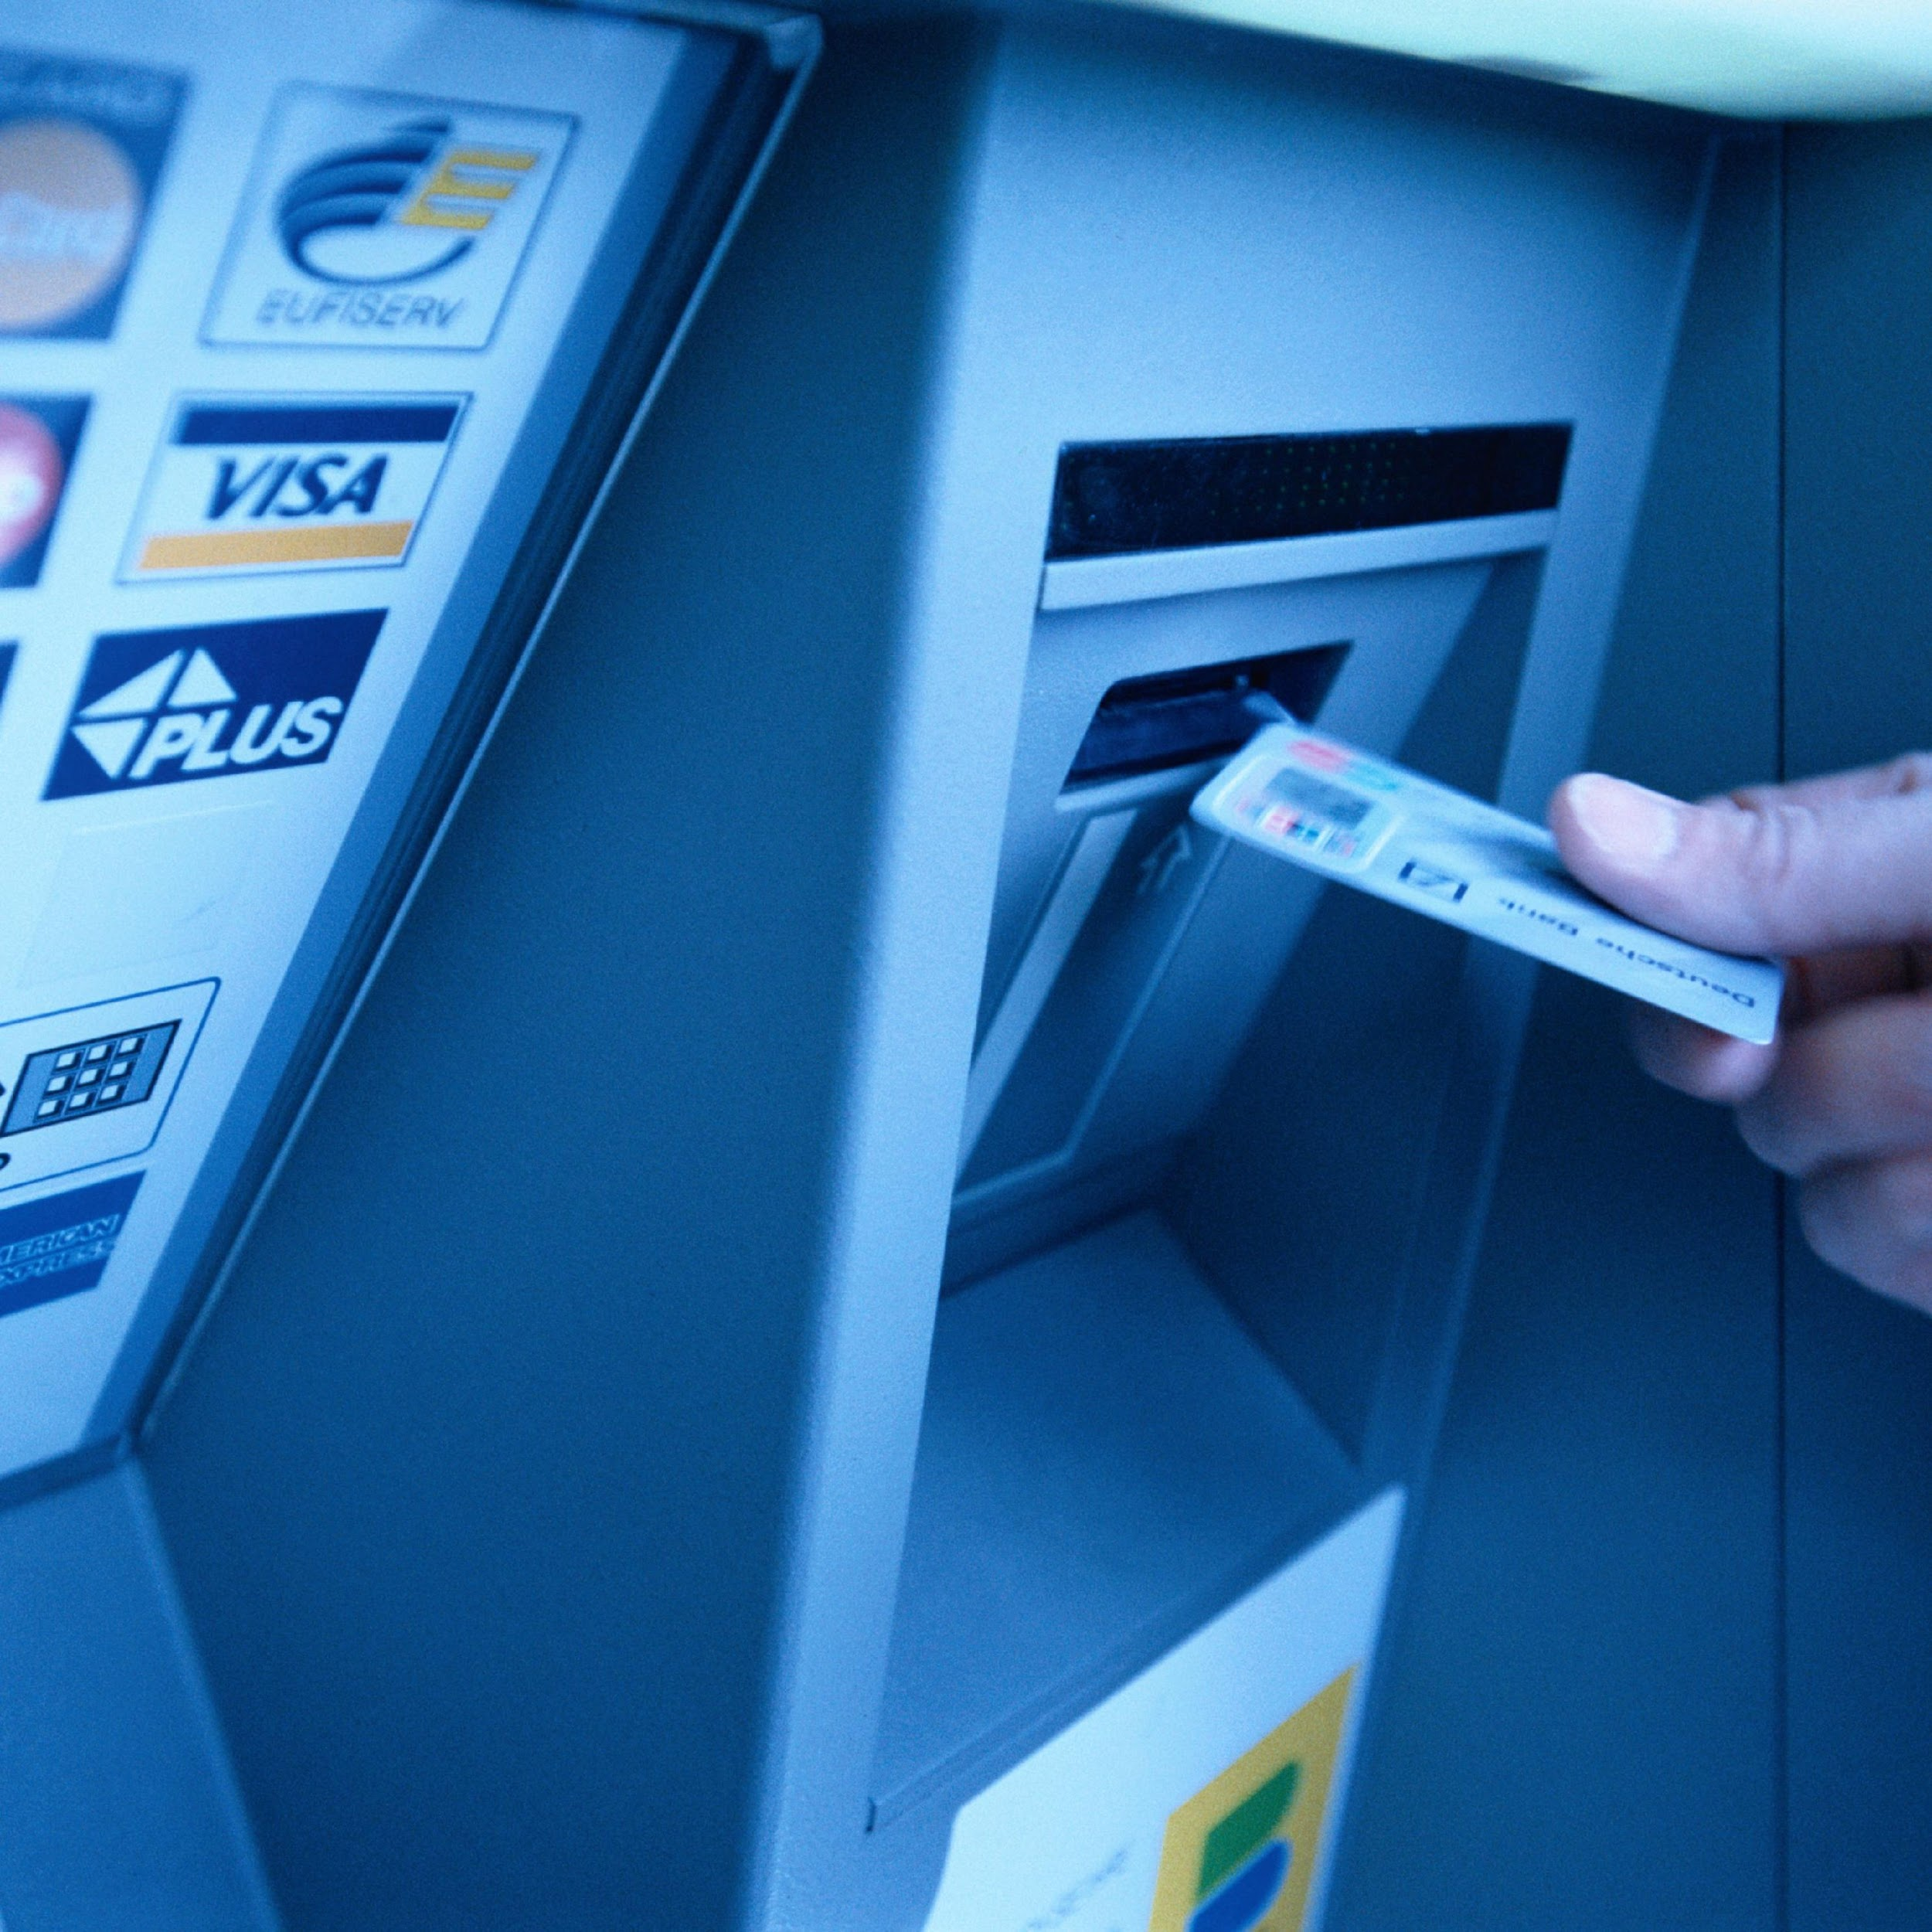
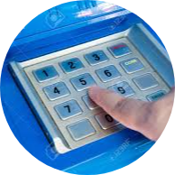
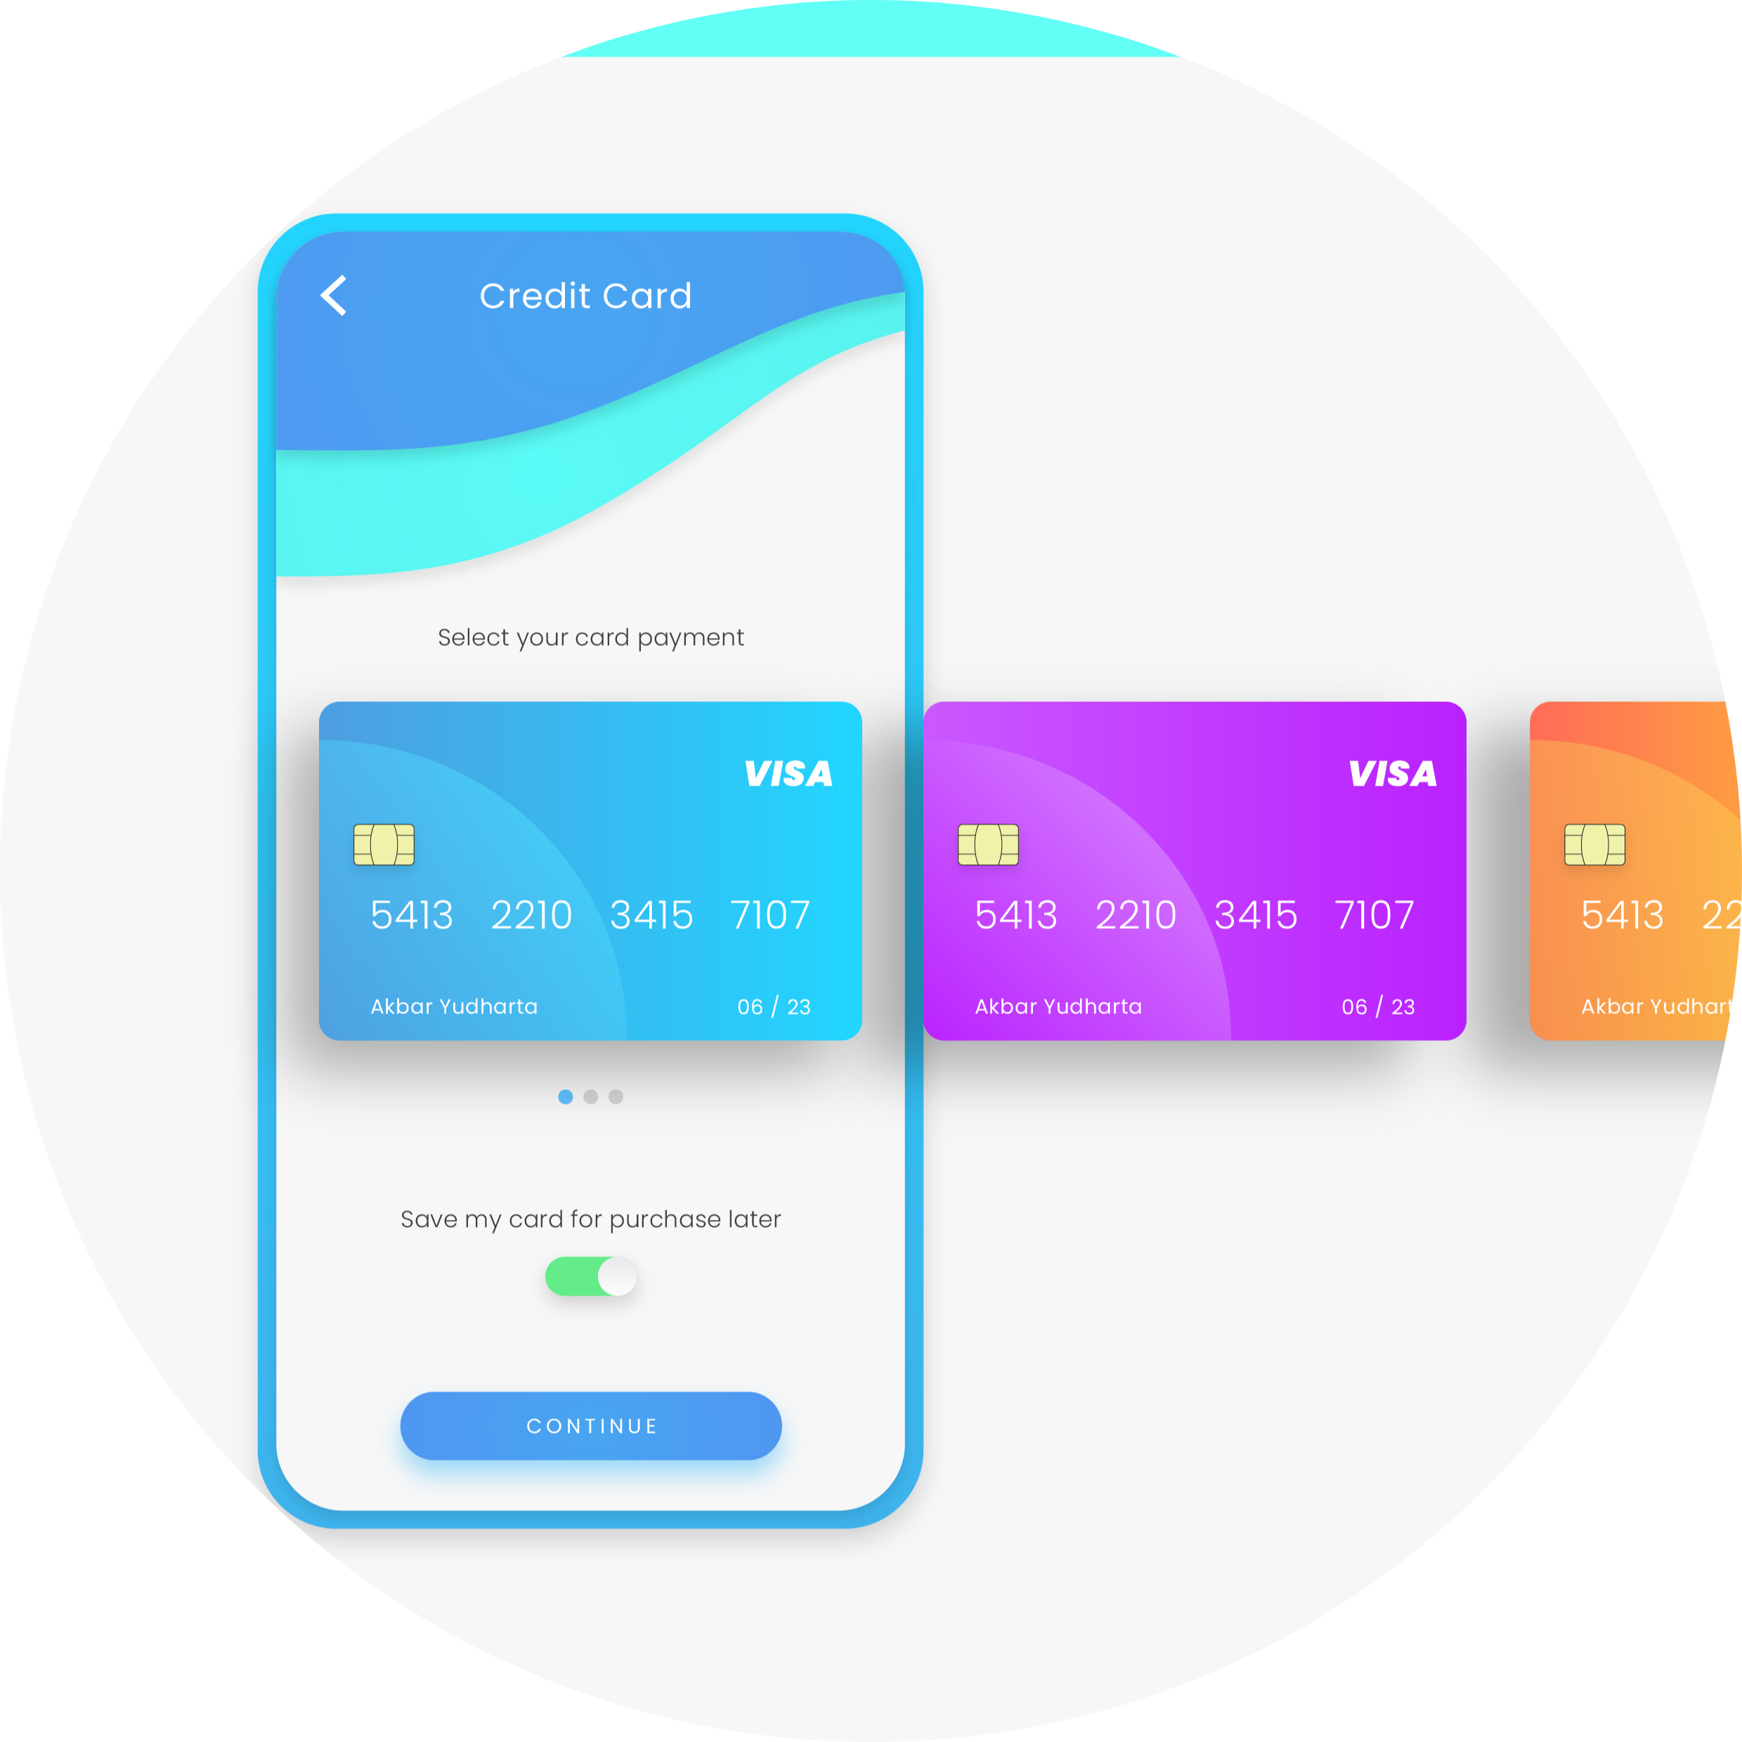
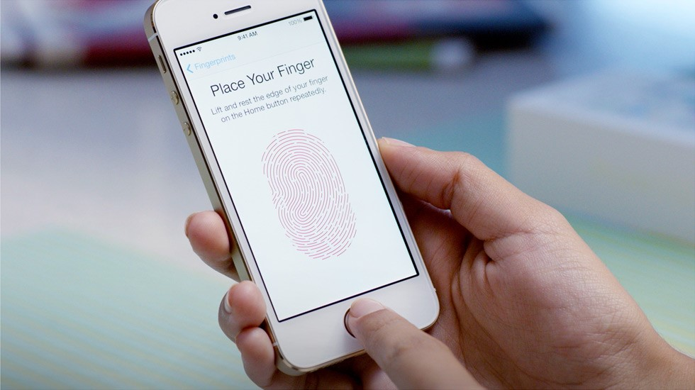
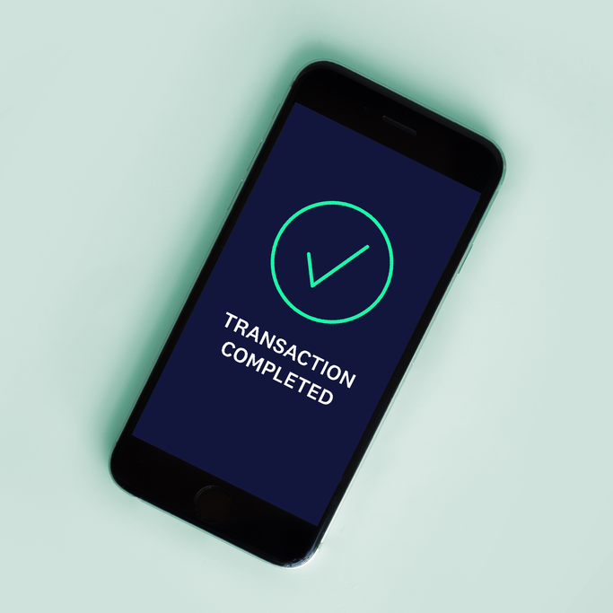
Remote Authorization for ATM Transactions using Fingerprint and T-OTP
PROCEDURE
Insert Card
Enter Amount
Select Card
Scan Fingerprint or Verify T-OTP
Complete Transaction

Slide 9
Remote Authorization for ATM Transactions using Fingerprint and T-OTP
EXISTING TECHNOLOGY
vs
OUR IMPLEMENTATION
Uses a less secure 4-digit PIN.
Single stage verification.
A card can only be linked to a single bank account.
The existing proposal requires every ATM to include fingerprint scanners.
Uses a unique time-based OTP.
Gives an option of fingerprint scan.
The smartcard can be linked to all of the user's accounts.
A dedicated application and a server is set up to facilitate transactions.

Slide 10
CHALLENGES
Remote Authorization for ATM Transactions using Fingerprint and T-OTP
Configuring the security setup. (ENCRYPTION & DECRYPTION)
Maintaining a database on the ATM server.
Development of a Flutter based Android application.
Setting up a time-based OTP verification system.

Slide 11
Remote Authorization for ATM Transactions using Fingerprint and T-OTP
METHODOLOGY
The methodologies implemented in the project to build the system are ATM Interface, T-OTP, Fingerprint Scan and User Card authentication.
REQUIREMENTS:
Flutter based Android application.
Python WebSockets server.
Time Based OTP system.
RFID Card Reader.
Raspberry Pi
Monitor

Slide 12
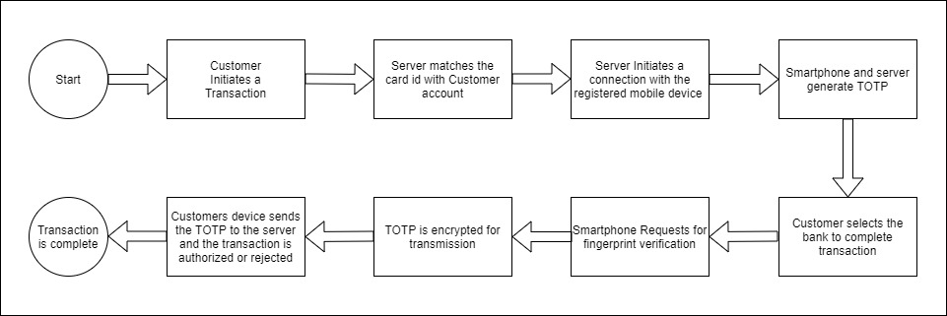
Remote Authorization for ATM Transactions using Fingerprint and T-OTP
METHODOLOGY

Slide 13
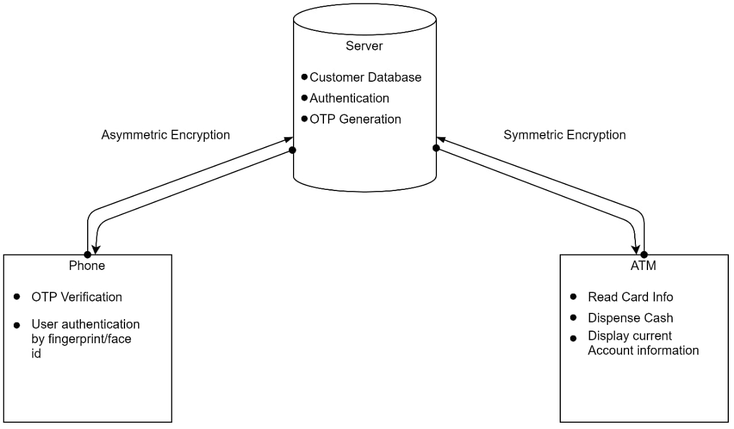
Remote Authorization for ATM Transactions using Fingerprint and T-OTP
FLOWCHART
Dept of ECE, SJBIT, 2020-21

Slide 14
PROGRESS TILL DATE.
Remote Authorization for ATM Transactions using Fingerprint and T-OTP
Flutter App :
Registration page
Sign in page
User home page
Hive database to maintain user records
UI to display multiple registered cards
UI to display the last 10 Transaction
Server :
Creating and Handling Concurrent Websocket Connections with client app
Handling connection with the atm machine
Backend SQL client database
Registration of new user
Generating unique customer id and 32 bit unique encryption key
Dept of ECE, SJBIT, 2020-21

Slide 15
PLAN OF ACTION
Remote Authorization for ATM Transactions using Fingerprint and T-OTP
Server:(15 Feb- 28 Feb)
Integrating Firebase for push notifications
Creating encryption-decryption subroutines
Handling Transaction Request
Option to add/remove cards
Generate and verify T-OTP
Flutter App:(1 March - 14 March)
Transaction Page
Creating encryption-decryption subroutines
Option to add/remove card and view previous Transactions
Integrate Firebase API
Generate T-OTP
ATM:(15 March- 31 March)
Building the ATM Interface
Interfacing with RFID/NFC Reader
Creating Transaction Request
Display Current status of Clients account
Dept of ECE, SJBIT, 2020-21

Slide 16
Remote Authorization for ATM Transactions using Fingerprint and T-OTP
REFERENCES
www.flutter.dev/ [1]
https://pycryptodome.readthedocs.io/en/latest/src/cipher/aes.html [2]
https://www.geeksforgeeks.org/rsa-algorithm-cryptography/ [3]
dev.mysql.com › doc [4]
www.raspberrypi.org › documentation [5]
https://www.cse.wustl.edu/~jain/cse574-06/ftp/rfid/index.html [6]
SBI implementation of OTP based system to withdraw amount above 10K [7]
Flutter for Beginners: An introductory guide to building cross-platform mobile applications with Flutter and Dart 2 Paperback – Import, 12 September 2019 [8]
Python Made Easy: Step by Step Guide to Programming and Data Analysis using Python for Beginners and Intermediate Level [9]

Slide 17
Remote Authorization for ATM Transactions using Fingerprint and T-OTP
THANK YOU!
Guided By:
Dr. K V Mahendra Prashanth
Head Of Department,
Electronics & Communication, SJBIT
Done By:
Shreyas MO (1JB17EC086)
Shreyas G (1JB17EC085)
Sumanth TP (1JB17EC090)
Tejas Muthya (1JB17EC095)

